Slide 1

The Generative AI Revolution: A Month-Long AI Exploration
Week 1 Day 1: 2nd Mar 2024

Slide 2

π
Generative AI Cohort March 2024
π

Slide 3

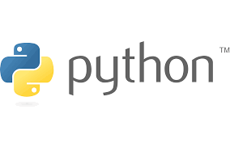




π
Agenda for GenAI(Beginners) Level-1
Introduction to Generative AI
Generative AI in Software Applications
Impact of Generative AI
Prompt Engineering
Projects: Student Assistant
Financial Assistant
Pizza Order bot
Laptop Genie bot

Slide 4
π
Agenda for GenAI (Professionals) Level-2
Embeddings
Vector Database
LangChain
RAG
Projects: Based on open source models (TBD)

Slide 5



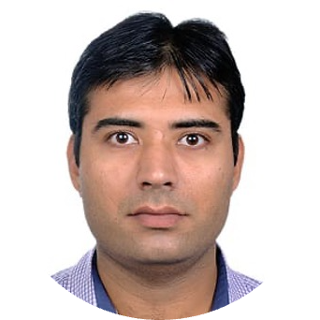


π
Our Team
Manoj Gupta
manoj-gupta-20541017
Raman Chopra​
raman-chopra
Mokarbeen Ansari
mokarbeenansari
Dinesh Chopra
dinesh-chopra
Vinit Narula
vinitnarula
Email: mentors@edquest.co.in
Notes:
Add Manoj's picture
We need to show or not

Slide 6
π
Introduction to Generative AI
What is Generative AI ?
Examples of Generative AI
Limitations of Generative AI
π

Slide 7
π
What is Artificial Intelligence ?
Artificial Intelligence
Machine Learning
Deep Learning
Generative AI
Notes:
Note: Redo it. Make ur own diagram

Slide 8
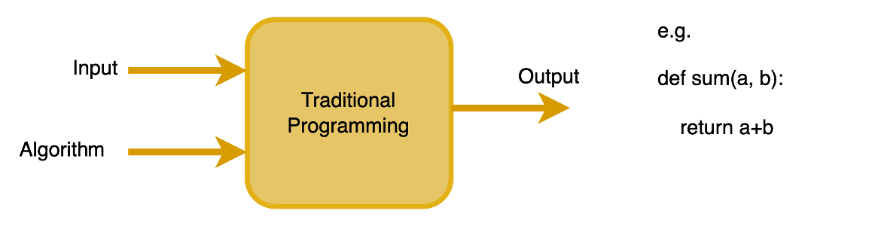
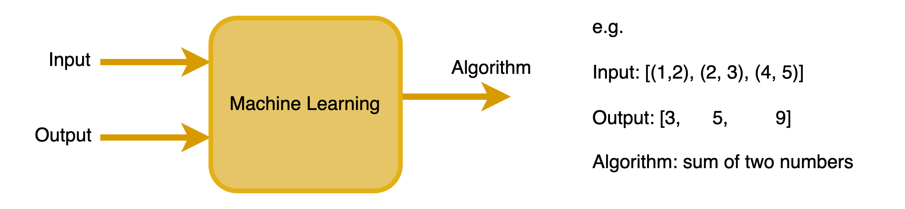
π
How is Traditional Programming Different From Machine Learning?
Notes:
Add one more section for Gen AI

Slide 9
π
Machine Learning & Deep Learning
Machine learning algorithms use historical data as input to predict new output values.
Deep learning uses neural networks with many layers to model complex patterns in data.
Spam Detection in Emails: ML algorithms can learn to identify spam emails by analysing thousands of examples and identifying common patterns and characteristics.
Recommendation Systems: Netflix and Amazon use ML to analyse your past behaviour and the behaviour of similar users to recommend products or movies.
Image Recognition: Deep learning models like CNNs are used in facial recognition systems and for accurately identifying objects within images.
Speech Recognition: Systems like Siri or Google Assistant use deep learning to understand spoken language, enabling users to interact with devices through voice commands.
Notes:
Story , How to teach a kid about apples and oranges, on the similar way Machine Learning learn by providing some examples.

Slide 10
π
What is Generative AI ?
Generative models learn the distribution of a dataset and can generate new data points. It specialises in creating new, previously unseen content by learning from existing data.
Deepfakes: Generative AI can create highly realistic video and audio recordings that appear to be genuine.
Art Creation: AI models can generate new artworks or music compositions by learning from vast collections of existing works.
Text Generation: Tools like OpenAI's GPT series can generate coherent and contextually relevant text based on a given prompt, mimicking human-like writing styles.
Notes:
Story , How to teach a kid about apples and oranges, on the similar way Machine Learning learn by providing some examples.

Slide 11
π
Generative AI Evolution
PaLM BLOOM OPT ChatGPT
GPT–1 BERT
GPT-3
Transformer
GPT-2 Megatron-LM
InstructGPT Cohere AI21 GPT-J
LLaMa ++ GPT-4 Antropic Titan Stable Code
2017 2018 2019 2020 2021 2022 2023
Notes:
REDO

Slide 12




π
Examples of Generative AI Applications

Slide 13
π
Examples of Generative AI for Text
Generative AI for text encompasses a wide range of models and techniques aimed at generating human-like text.
Story Generation
Dialogue Generation
Poetry Generation
Code Generation
Translation
Text Summarization
Content Creation
Storytelling Assistants
Fan Fiction Generation
Email Generation
Notes:
Add Gen AI for Text
Also make these 3 slides consistent Text/Image/Audio

Slide 14


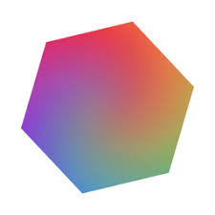


π
Examples of Generative AI for Image
DALL.E (OpenAI)
MidJourney (accessed via discord)
Dream Studio (stability ai)
Firefly (Adobe)
Getty (Getty)
Notes:
Add Gen AI for Text
Also make these 3 slides consistent Text/Image/Audio

Slide 15
π
Examples of Generative AI for Audio
LOVO
11-LABS
SPEECHIFY
MURF
Many more ...
More Details: https://www.youtube.com/watch?v=hxnTwyx8GS8

Slide 16
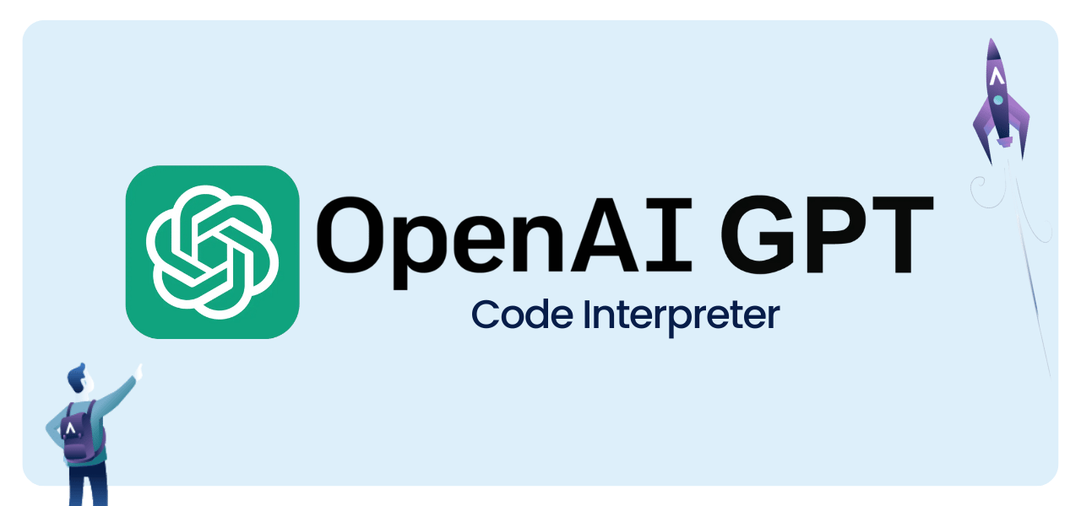

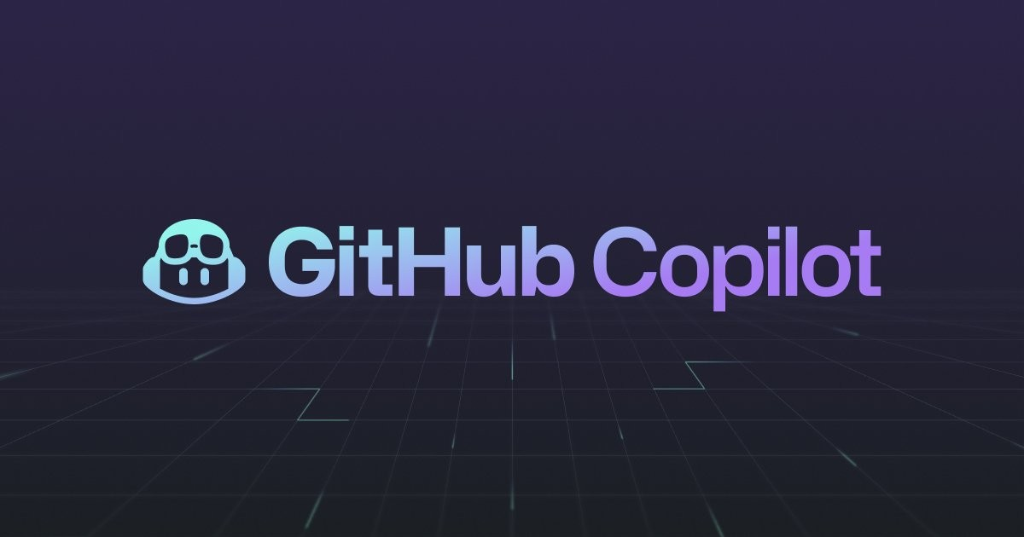
π
Code Generation

Slide 17
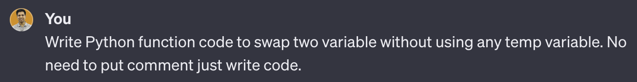
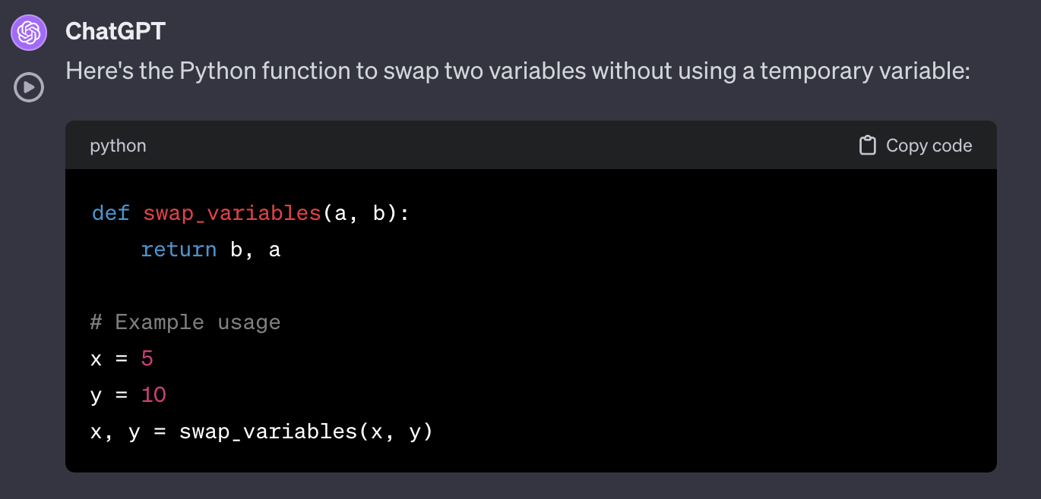
π
Code Generation: Example
Notes:
Blackbox: code generation from image

Slide 18
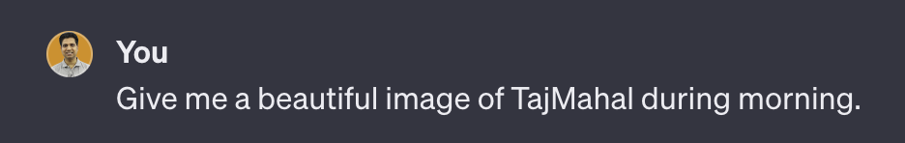
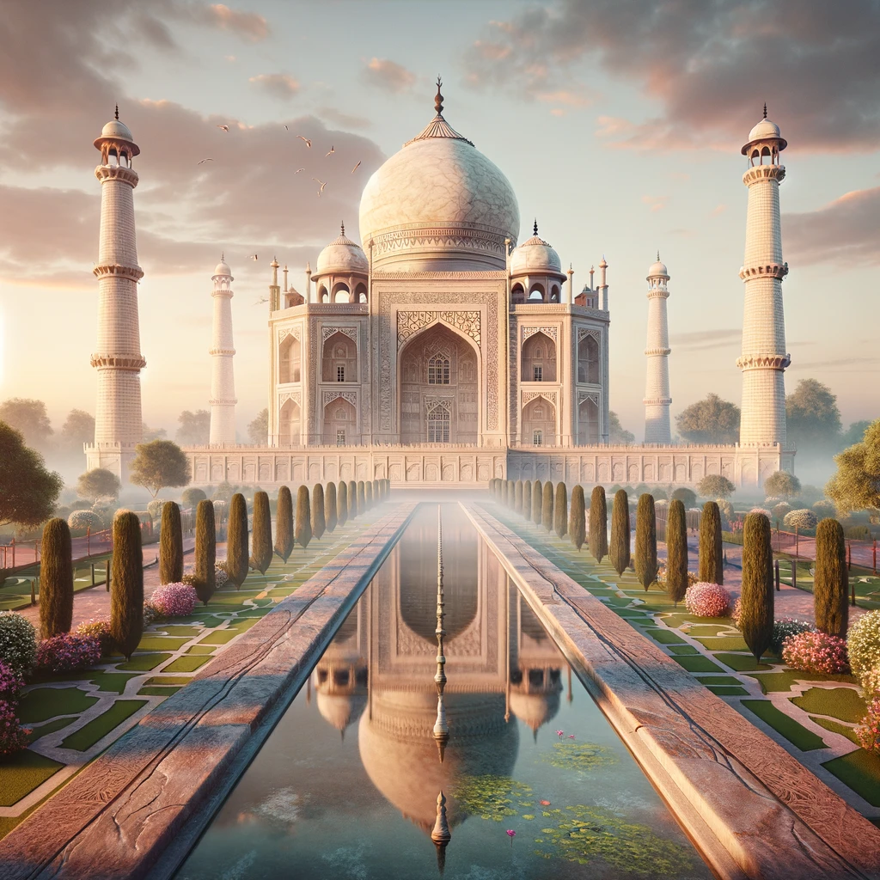
π
Image Generation: Example

Slide 19

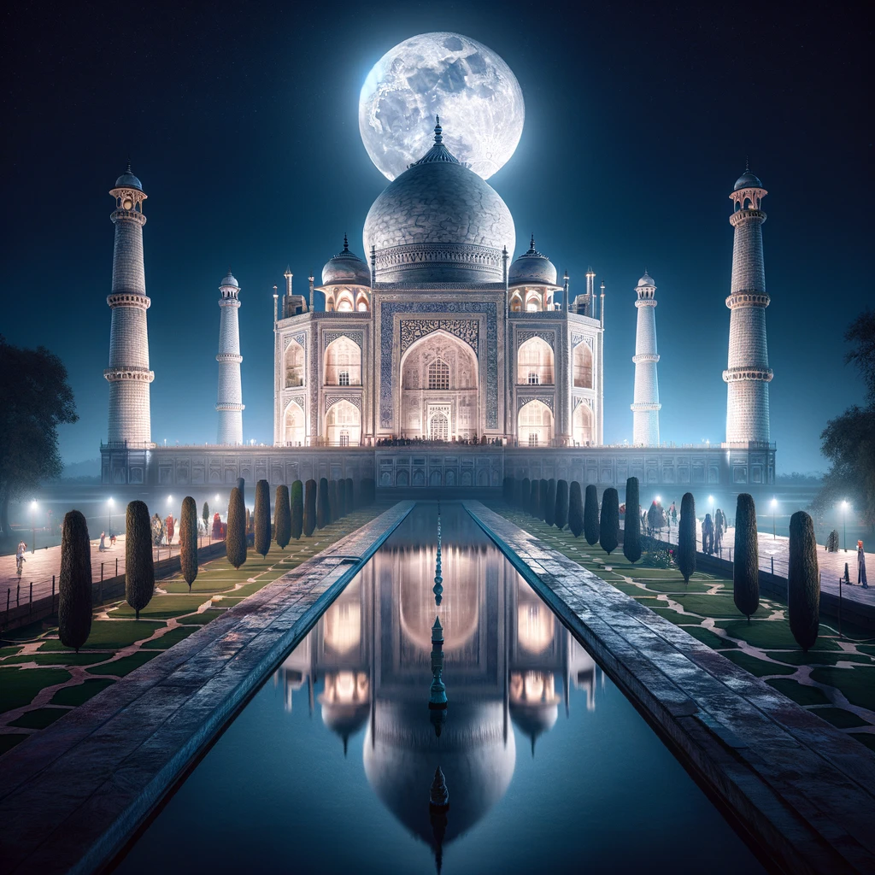
π
Image Generation: Example

Slide 20
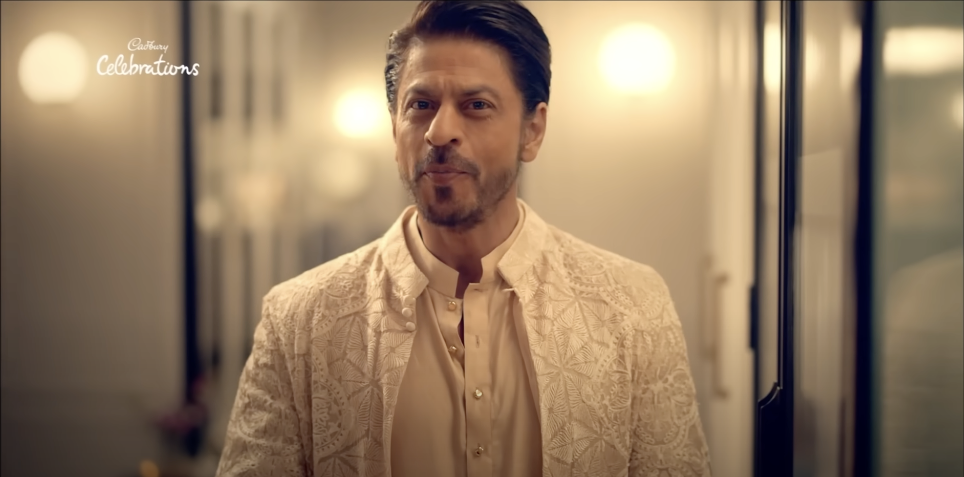
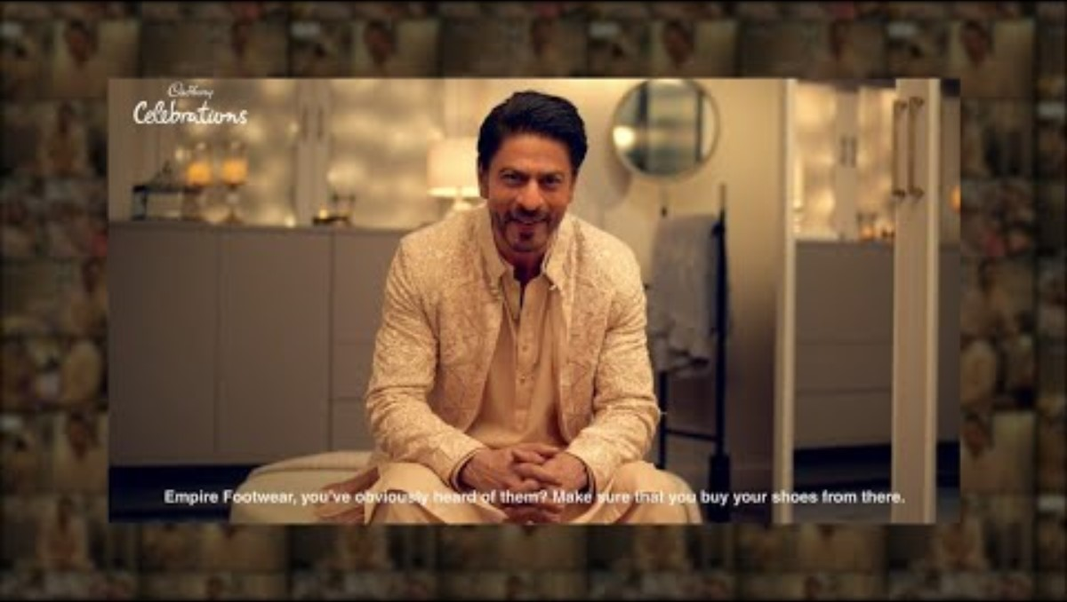
π
Video Generation
Generate video for advertisement
Product education
Product training
Link: https://youtu.be/5WECsbqAQSk?si=Hy6d4hfz2Oq_1LzA

Slide 21



π
Communications Channels
WhatsApp: https://whatsapp.com/channel/0029VaOManvEKyZMoPCtPU24
Discord: https://discord.gg/r4pNVqcpCr
LinkedIn: https://www.linkedin.com/company/edquestofficial/

Slide 22

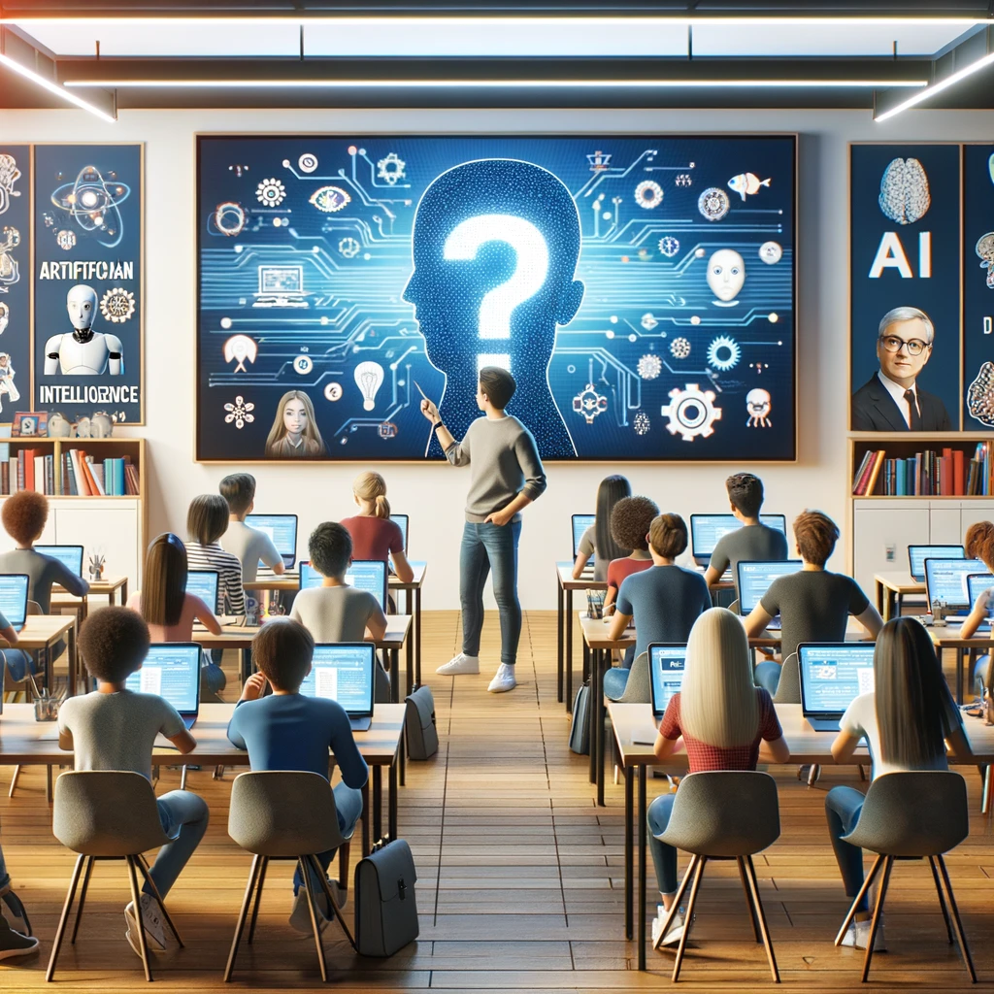
π
Q & A

